Slide 1

Merge Sort and Merging
Data Structure | Searching and Sorting
Course: Data Structure | Chapter: Searching and Sorting | Bachelor of Engineering
DISCOVER · LEARN · EMPOWER
Notes:
Welcome everyone to today's session on Merge Sort. We are diving deep into Unit-3, specifically focusing on the divide-and-conquer strategy. This algorithm is a cornerstone for understanding efficient sorting in large datasets.

Slide 2
Course Outcomes
SLIDE 2 / 14
Course Outcome
CO | BT LEVEL | DESCRIPTION
CO1 | BT1 | Understand and apply basic data structures, algorithms, complexity analysis, ADTs, arrays and linked lists.
CO2 | BT2 | Apply and implement stacks and queues in problem-solving.
CO3 | BT3 | Analyse and apply searching, sorting, and hashing techniques.
CO4 | BT4 | Construct and apply tree structures and traversal techniques.
CO5 | BT5 | Represent and solve graph problems using DFS, BFS, and graph algorithms.
Chandigarh University
2 / 14
Notes:
Although our focus is sorting, these outcomes connect to the recursive tree structure of Merge Sort. The divide phase mirrors tree traversal, while the merge phase relates to graph connectivity logic. Understanding this helps you solve complex graph problems later.

Slide 3
Learning Objectives
SLIDE 3 / 14
Learning Outcomes
1
Analyze the divide-and-conquer strategy used in Merge Sort.
2
Evaluate the time complexity differences between best and worst cases.
3
Construct the merge process step-by-step for unsorted arrays.
4
Compare Merge Sort stability against other sorting algorithms like Quick Sort.
5
Apply the algorithm to solve real-world data organization problems.
Chandigarh University
3 / 14
Notes:
By the end of this lecture, you will not just know how to code Merge Sort. You will understand why it is stable and how its recursive nature impacts performance. We will analyze the trade-offs between time and space complexity.

Slide 4
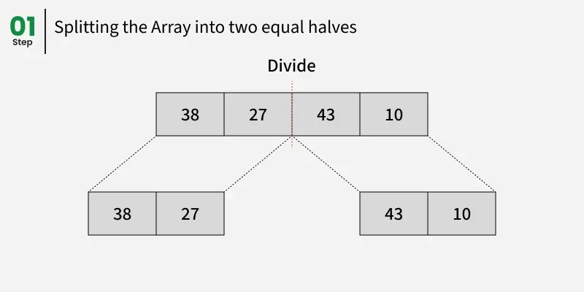
Lecture
SLIDE 4 / 14
Divide and Conquer Strategy
1
Divide the unsorted list into n sublists, each containing one element.
2
Conquer by recursively sorting each sublist until base cases are reached.
3
Combine the sorted sublists to produce the final sorted output.
4
The recursion depth is logarithmic, specifically log base 2 of n.
5
This approach ensures consistent performance regardless of initial data order.
6
Base case occurs when a sublist has zero or one element.
7
The strategy transforms a complex problem into manageable smaller subproblems.
Merge Sort - GeeksforGeeks
Chandigarh University
4 / 14
Notes:
Think of this like splitting a large pile of unsorted papers. You keep splitting until every paper is in its own hand. Then you start combining them in order. This recursive splitting is the heart of the algorithm.

Slide 5
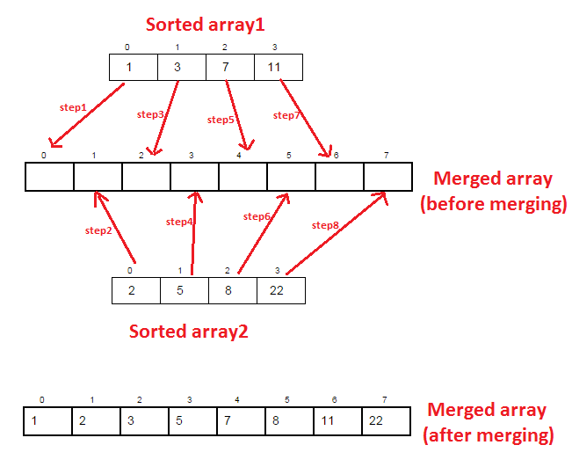
Lecture
SLIDE 5 / 14
The Merge Process Logic
1
Compare the first elements of two sorted subarrays simultaneously.
2
Select the smaller element and place it into the temporary array.
3
Advance the pointer of the subarray from which the element was taken.
4
Repeat the comparison until one subarray is completely exhausted.
5
Copy any remaining elements from the non-empty subarray to the result.
6
The merge operation requires linear time proportional to the input size.
7
This step ensures the final combined array remains sorted.
Source: lh5.googleusercontent.com
Chandigarh University
5 / 14
Notes:
Imagine two lines of students sorted by height merging into one line. You look at the front of both lines and pick the shorter student. You repeat this until one line is empty, then add the rest. This is the merge logic.

Slide 6
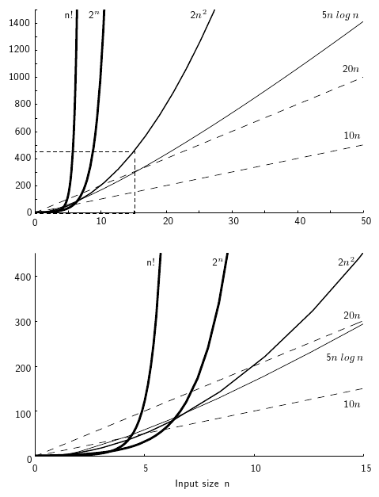
Lecture
SLIDE 6 / 14
Time Complexity Analysis
GOVERNING EQUATION
The recurrence relation is T(n) = 2T(n/2) + O(n)
1
Best case time complexity is O(n log n) for any input.
2
Worst case time complexity is O(n log n) regardless of order.
3
Average case time complexity remains O(n log n) consistently.
4
The O(n) term represents the linear time required for merging.
5
The log n factor comes from the depth of the recursion tree.
6
This consistency makes it superior to Quick Sort in worst cases.
Source: opendsa-server.cs.vt.edu
Chandigarh University
6 / 14
Notes:
Unlike Quick Sort, Merge Sort never degrades to O(n squared). Even if your data is already sorted or reverse sorted, the time taken is the same. This predictability is crucial for real-time systems where worst-case performance matters.

Slide 7
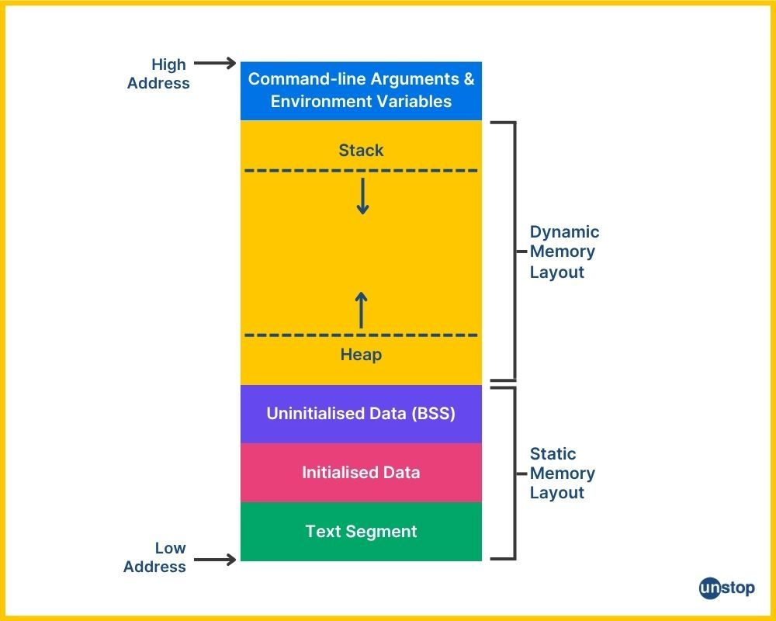
Lecture
SLIDE 7 / 14
Space Complexity Considerations
1
Merge Sort requires O(n) auxiliary space for temporary arrays.
2
The space is needed to store the merged results during recursion.
3
This is a trade-off for achieving guaranteed O(n log n) time.
4
In-place variants exist but are significantly more complex to implement.
5
The recursion stack also consumes O(log n) space implicitly.
6
Memory usage scales linearly with the size of the input array.
7
This makes it less suitable for very large datasets with limited RAM.
Source: d8it4huxumps7.cloudfront.net
Chandigarh University
7 / 14
Notes:
The main drawback is memory. You need extra space equal to the size of your array to perform the sort. If you have a massive dataset on a machine with limited RAM, this could be a bottleneck compared to in-place sorts.

Slide 8
Lecture
SLIDE 8 / 14
Stability of Merge Sort
1
Merge Sort is a stable sorting algorithm by design.
2
Stability means equal elements retain their original relative order.
3
The merge logic prioritizes the left element when values are equal.
4
This property is vital for sorting records with multiple keys.
5
Quick Sort is generally unstable without specific modifications.
6
Stability allows for multi-key sorting without complex re-sorting.
7
It ensures predictable behavior when sorting objects with identical keys.
Chandigarh University
8 / 14
Notes:
Stability is a key feature. If you sort a list of students by grade, and then by name, a stable sort ensures the grade order is preserved for students with the same name. Merge Sort guarantees this naturally.

Slide 9
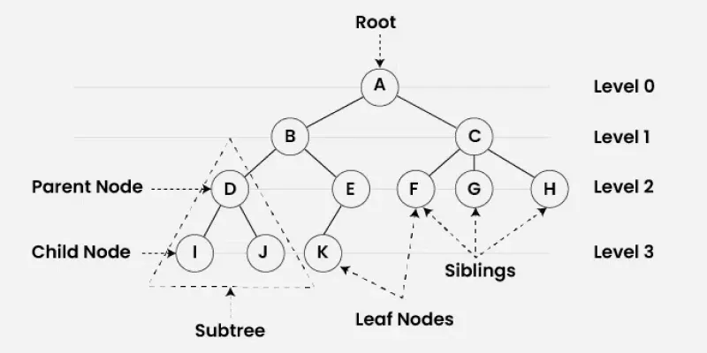
Worked Example
SLIDE 9 / 14
Initial Split
START WITH ARRAY
[38, 27, 43, 3, 9, 82, 10].
DIVIDE INTO LEFT HALF
[38, 27, 43, 3] and right half: [9, 82, 10].
• Recursively split left half into [38, 27] and [43, 3].
• Recursively split right half into [9] and [82, 10].
• Continue splitting until every sublist contains exactly one element.
• The recursion tree depth for 7 elements is 3 levels.
• This phase creates the base cases required for merging.
Source: media.geeksforgeeks.org
Chandigarh University
9 / 14
Notes:
Let's trace this. We take our 7 numbers and split them in half. Then we split those halves again. We keep doing this until we have single numbers like [38], [27], [43], and so on. This is the 'divide' phase.

Slide 10
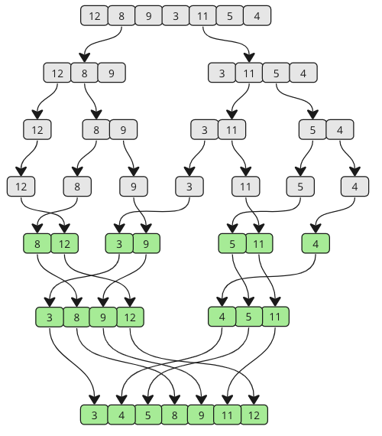
Worked Example
SLIDE 10 / 14
First Merges
1
Merge [38] and [27] to produce [27, 38].
2
Merge [43] and [3] to produce [3, 43].
3
Merge [9] and [10] to produce [9, 10].
4
Merge [82] with the result of [9, 10] to get [9, 10, 82].
5
Compare 27 and 38 with 3 and 43 in the next step.
6
The sorted subarrays grow in size at each merge level.
7
Each merge operation maintains the sorted order of elements.
Source: www.w3schools.com
Chandigarh University
10 / 14
Notes:
Now we merge back up. We take [38] and [27], compare them, and get [27, 38]. Similarly, [43] and [3] become [3, 43]. We do this for all pairs. Notice how the sorted segments get larger with every step.

Slide 11
Worked Example
SLIDE 11 / 14
Final Merge
THE FINAL SORTED ARRAY IS
[3, 9, 10, 27, 38, 43, 82].
• Merge [27, 38] and [3, 43] to get [3, 27, 38, 43].
• Merge [9, 10] and [82] to get [9, 10, 82].
• Compare elements from [3, 27, 38, 43] and [9, 10, 82].
• Select 3, then 9, then 10, then 27, then 38.
• Finally select 43 and 82 to complete the array.
• The process demonstrates the complete divide-and-conquer cycle.
Chandigarh University
11 / 14
Notes:
Finally, we merge the two large halves. We compare 3 with 9, pick 3. Then 27 with 9, pick 9. We continue until the array is fully sorted. The result is [3, 9, 10, 27, 38, 43, 82].

Slide 12
Lecture
SLIDE 12 / 14
Common Pitfalls and Errors
1
Incorrect base case handling can cause infinite recursion loops.
2
Off-by-one errors in index calculation lead to array bounds.
3
Failing to copy remaining elements results in incomplete output.
4
Using the same array for input and output causes data loss.
5
Ignoring stability requirements can lead to incorrect relative ordering.
6
Not allocating sufficient temporary memory causes runtime crashes.
7
Misunderstanding the merge logic leads to unsorted final results.
Chandigarh University
12 / 14
Notes:
Students often make off-by-one errors when calculating midpoints. Another common mistake is forgetting to copy the remaining elements from one subarray after the other is empty. Always double-check your base cases to avoid infinite loops.

Slide 13
Lecture
SLIDE 13 / 14
Key Takeaways
1
Merge Sort uses a divide-and-conquer strategy for sorting.
2
It guarantees O(n log n) time complexity in all cases.
3
The algorithm is stable, preserving order of equal elements.
4
It requires O(n) auxiliary space for temporary storage.
5
The merge process combines two sorted subarrays into one.
Chandigarh University
13 / 14
Notes:
To summarize: Merge Sort is reliable, fast, and stable. It trades space for consistent speed. Remember the recurrence relation and the merge logic as these are the core concepts for your exams.

Slide 14
Lecture
SLIDE 14 / 14
References
DATA STRUCTURES
A Pseudocode Approach with C — Gilberg, Forouzan
• Data Structures — Lipschutz
• Data Structure Using C — AK Sharma
• C and Data structure — P. S. Deshpandey
Chandigarh University
14 / 14
Notes:
Please refer to these standard textbooks for further reading and practice problems. Gilberg and Forouzan provide excellent pseudocode, while Lipschutz offers a comprehensive theoretical background. Sharma and Deshpandey are great for C-specific implementations.

